Slide 1

DEVELOPTHON 2020 Code for Social Impact
TECHNIOSYS
Aditi Chaurasia
Akshay Jain
Riya Gupta

Slide 2
1. Problem Statement Assigned (Brief Description about the problem statement.)
The problem statement is to select, design this and implement the appropriate data structure on the server-side and visualize this across multiple levels on the UI / client-side. This has to work across form factors on the UI - web, tablet, mobile.
Problem Statement by Tapplent
Description: The problem clearly states to find a solution when a certain level employee leaves, the hierarchy should be rearranged without disturbing the day to day work of the organization and keeping the data about the present and past employee still in the database separately. Also, the level of hierarchy is traced along the with the mentors an employee answers to or he/she manages.

Slide 3
“Here, we describe our approach in a simple graphical model”

Slide 4
Present Organization Structure
CEO
manager
1
manager2
Coordinator
1
Coordinator 2
Coordinator 3
Coordinator 4
Employee1
Employee 3
Employee 5
Employee 6
Employee2
Employee 4

Slide 5
When an in-between node gets deleted ( say, coordinator 1 )
CEO
manager
1
manager2
X
Coordinator 2
Coordinator 3
Coordinator 4
Employee1
Employee 3
Employee 6
Employee 5
Employee2
Employee 4

Slide 6
Special case : matrix manager
CEO
manager
1
Matrix manager
manager2
Coordinator
1
Coordinator 2
Coordinator 3
Coordinator 4
Employee1
Employee 3
Employee 5
Employee 6
Employee2
Employee 4

Slide 7
contd
CEO
Matrix manager
manager
1
manager2
X
Coordinator 2
Coordinator 3
Coordinator 4
Employee 3
Employee 5
Employee 6
Employee1
Employee2
Employee 4

Slide 8
Special case : New employee with a new position is added between two levels ( or positions )
CEO
NEW
manager
1
manager2
Coordinator
1
Coordinator 2
Coordinator 3
Coordinator 4
Employee 3
Employee1
Employee 4
Employee2
Employee 5
Employee 6

Slide 9
Cover Up The 4 Major Points as Listed Below
To develop a backend and frontend prototype for managing an organization’s employee using concept of trees but without using INHERITANCE
Effective hierarchy management, matrix management, easy appending of a new level in the hierarchy along with removal and replacement employees.
Backend: PYTHON, Frontend: FLASK, DB: sqlite3, Data Structure: Dictionaries, Notebook: Jupyter, Libraries: sqlite, flask (render_template, request)
Implementation in React or Angular JS, NoSQL DB, Django.
Extra Points:
Depth between two levels.
The number of vacant positions.
Adding a new job description in between and managing it into the hierarchy.

Slide 10
Your
Impact
We are introducing new job descriptions i.e. more employment.
Avoiding the chaos in the organisation for reporting the higher-ups.

Slide 11
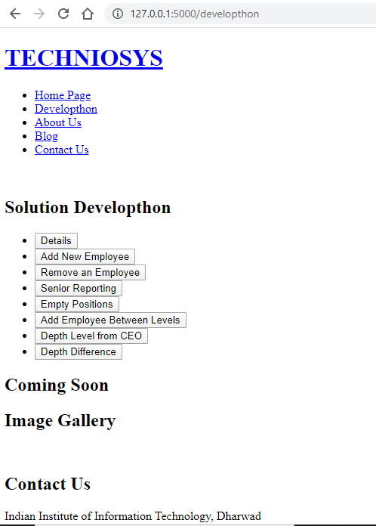
DESKTOP PROJECT
We are creating button which have functions behind them and the result is printed on the screen.

Slide 12
Any Other Attachments/ Details
Each function is written of an a single cell to give modularity, File is attached as Back End IPython Notebook.
Database is present.db which is sqlite based.
FrontEnd is also a IPython Notebook.
All the files are attached in the same folder as this presentation.
https://drive.google.com/open?id=1GmOhJIO460UIyNvVdx9_7GH8tj6LK3-i

Slide 13
Any questions?
THANK YOU!!

